Slide 1
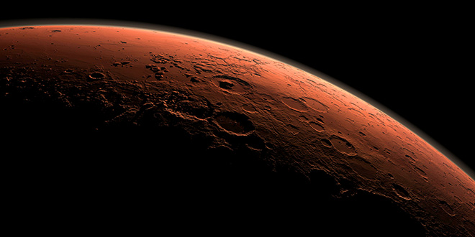
Are We Ready for the Final Frontier?
An Evaluation of the Mars One Project
Kira Neuman

Slide 2
What is Mars One?
Timeline: [1]
2011: Mars One founded
2015: candidate training begins
2020: Demonstration Mission launch
2022: Rover and satellite launch
2026: first crew leaves Earth
2027: first crew lands on Mars
[1]
[1]

Slide 3
Risk to Human life
Who is responsible for the risk?
Astronauts
Company
3 potential causes for harm
Technology failures
Funding restrictions
Physical illness

Slide 4
Technical Feasibility
Replacement parts will make up 62% of future launches [2]
Oxygen levels will become unstable after 68 days [2]
[3]

Slide 5
Financial Feasibility
Projected Cost
6 billion for the first 4 astronauts [1]
4 billion for all later trips
Comparison: Boeing earns 5 billion annually [3]

Slide 6
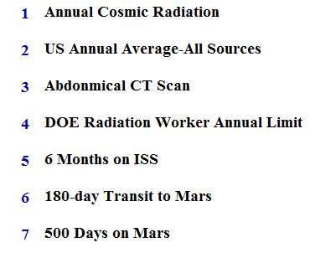
Health Feasibility
[4]

Slide 7
The solution
Stop current timeline
Develop technology and remotely test on mars
Aim for short term manned missions

Slide 8
References
[1] Mars One, 2015. [Online] Available: http://www.mars-one.com/. [Accessed May 7, 2015].
[2] J. Chu, “Mars One (and done?),” MIT News, Oct. 14, 2014. [Online] Available: http://newsoffice.mit.edu/2014/technical-feasibility-mars-one-1014. [Accessed May 7, 2015].
[3] “The worlds biggest public companies,” Forbes, 2015. [Online] Available: http://www.forbes.com/global2000/list/#search:boeing. [Accessed May 7, 2015].
[4] “PIA17601: radiation exposure comparisons with Mars trip calculation,” NASA, Dec. 9, 2013. [Online] Available: http://photojournal.jpl.nasa.gov/catalog/PIA17601. [Accessed May 7, 2015].

