Slide 1
Spanish in Yakima
Kira Neuman
Alexa Celerian

Slide 2
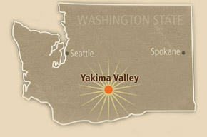
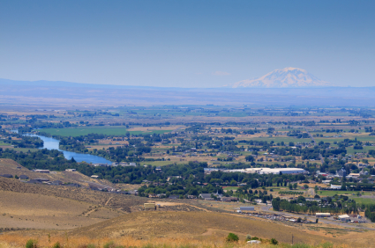
Yakima
Map

Slide 3
Yakima
Current Population
City – 92,521
County – 247,141
Spanish Speakers in Yakima Proper
Total – 28,080
English Ability
Very Well - 24.7%
Well – 23.5%
Not Well – 20.3%
Not at All – 14.6%
Source: American Communities Survey 2011

Slide 4
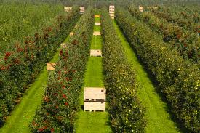
Economy
Agriculture
580,00 acres of land
$850 million per year
apples, hops, pears, cherries, grapes, mint, corn
New Industries
Fruit packaging/storage
Manufacturing
Wineries

Slide 5
Growth
Mexican mules packers in the 19th century
Increased immigration due to Mexican revolution from 1910-1920’s
Approx. 50,000 seasonal workers per year

Slide 6
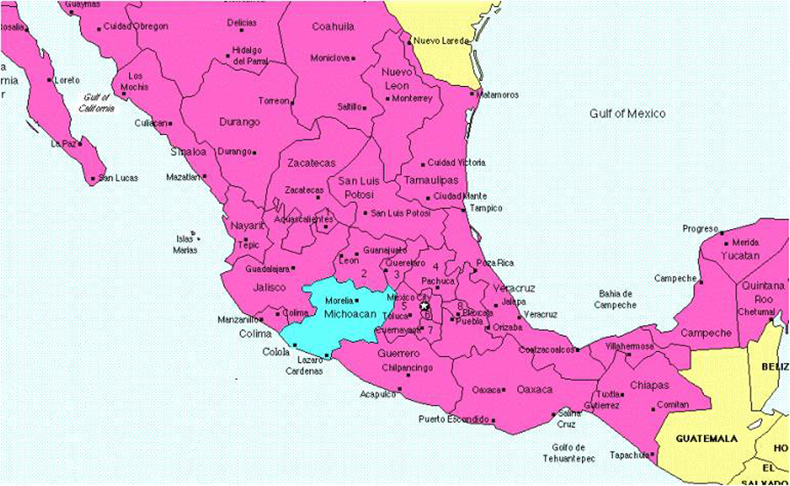
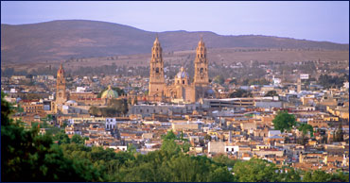
Sister City
Morelia – capital of Michoacán, Mexico
Initiated in 1995, Official since 1999
Association hosts
cultural events
and outreach

Slide 7
Language Maintenance
Over the past decade, the swelling Latino population in this fruit-growing valley has been reflected in everything from popular Mexican radio stations to the largest Cinco de Mayo festivals in the state, and even a visit from the president of Mexico.
Language maintenance denotes the continued use of a language in the face of competition from a regionally and socially more powerful language.

Slide 8
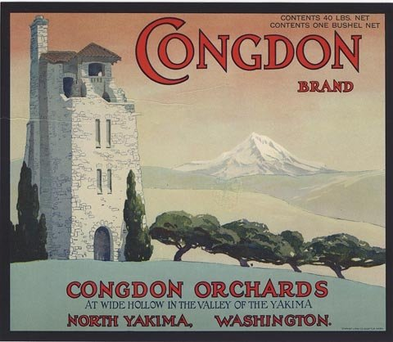
Continuous Flux of Immigrant Arrivals
Workers follow the crops, and friends and relatives follow them, settling together here as they lived together in Mexico, creating underground sister cities.
About 100,000 migrant and seasonal farmworkers labor in the Yakima County
Case study: Congdon Orchards fruit packing plant .
The first warehouse had about 100 employees
3 Caucasians, 2 African Americans and everyone else mostly Mexicans
2nd warehouse- 300 employees
12 Caucasians and the rest mostly Mexicans

Slide 9
Ongoing Contact with Family and Friends in Mexico
Interview Responses:
Maria Espinosa
“My family and I travel down to Mexico by car every other year. It usually takes several days because we’re from Guadalajara but it’s definitely worth the travel time to have a chance to see my only living grandmother and my cousins. It’s funny though since everyone in Mexico makes fun of my Spanish because apparently I have an accent, but I can’t really tell. I never really learned Spanish through formal education and I just mostly picked it up from my parents. I was born here in Yakima and I’ve lived here all of my life.”

Slide 10
Endogamous Marriages
Interview Response:
Lisandro Bautista
“Most of my family members seem to be married to Mexican- Americans also. Some of my family members are married to people of other races but the majority of them seem to get married to Latinos also. This makes sense because the older generations are usually only fully proficient in Spanish and if we have to introduce our future wives [or husbands] to our parents or grandparents, it is pretty important that they are able to communicate to them. It is going to be hard if we have family gatherings and our spouses aren’t able to communicate or take part because they can’t speak Spanish. “

Slide 11
Use of Spanish in a number of domains
first generation transmits the Spanish language to the second generation by means of their use of Spanish only at home and by encouraging as well as supporting the integration of their children in the Spanish community
No heritage schools

Slide 12
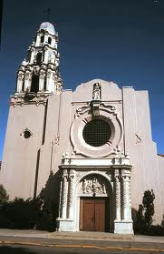
Hispanic Ministry
“Unite and coordinate efforts within a Pastoral de Conjunto (Collaborative Pastoral Model), seeking the integration and participation of the Hispanic Community in the life of the Church and society in Central Washington”

Slide 13
Spanish Radio Stations/ Channels
A. Yakima's KCJ has weekday broadcasts of area news, sports and commercials in Spanish on local Channel 17
B. La Voz del Campesino -Radio KDNA is the only full-time educational Spanish language public radio station in the United States

Slide 14
Publications
In Yakima, the Herald-Republic newspaper, which is owned by The Seattle Times Co., publishes a Spanish-language weekly called El Sol de Yakima.

Slide 15
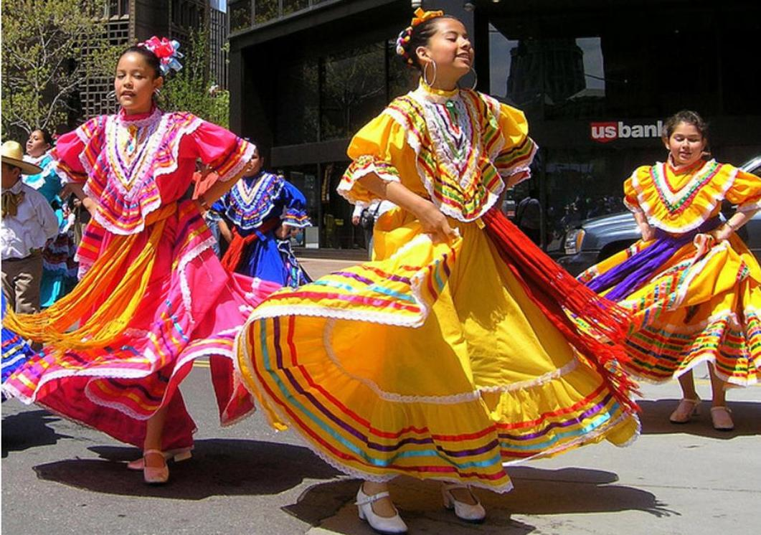
Cultural Activities
Día de los Muertos or Day of the Dead
Largest Cinco de Mayo in Washington State

Slide 16
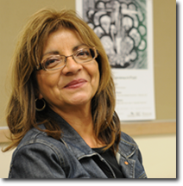
Organizations
MEChA- A national student organization to promote the culture, self-determination, and political health of Chicanos, Movimiento Estudiantil Chicano de Azltan (MEChA)
Interview with a Key Community Leader- Maria Cuevas (Sociology and Chicano Studies Instructor)

Slide 17
Participants' attitudes towards English
CONEVyT (Consejo Nacional de Educacion para la Vida y el Trabajo, or National Education Council for Life and Work) portal, an online program developed by the Mexican government, adopted by the Yakima School District ..
- reduce dropout rate from about 20 percent a few years ago - the highest in the state - to 7 %
All the participants expressed the importance of having adequate English and Spanish for their children’s well-being in Yakima

Slide 18
Conclusion

Slide 19
Works Cited
Guzman, Gonzalo. "Latino History of Washington State." History Link. Washington State Department of Archeology and Historic Preservation. 27 Aug. 2006. Web. 02 Mar. 2013.
"History of Yakima-Morelia Sister City Association." Yakima Morelia Sister City Association. Yakima Morelia Sister City Association, 2012. Web. 08 Mar. 2013.
U.S. Census Bureau. “Age by Language Spoken at Home and Ability to Speak English, 1990.” Social Explorer. Web. 03 Mar. 2013
U.S. Census Bureau. “Hispanic Origin by Race, 1990.” Social Explorer. Web. 03 Mar. 2013
U.S. Census Bureau. “Language Spoken at Home by Ability to Speak English For the Population 5 years and over (Hispanic or Latino), ASC 2011.” Social Explorer. Web. 03 Mar. 2013
U.S. Census Bureau. “Mother Tongue and Nativity, 1970.” Social Explorer. Web. 03 Mar. 2013
U.S. Census Bureau. “Place of Birth (White Population), 1910.” Social Explorer. Web. 03 Mar. 2013
U.S. Census Bureau. “Race, 1910.” Social Explorer. Web. 03 Mar. 2013
U.S. Census Bureau. “Spanish Origin or Descent Indicator, 1970.” Social Explorer. Web. 03 Mar. 2013
U.S. Census Bureau. “Total Population, ASC 2011.” Social Explorer. Web. 03 Mar. 2013
"Yakima County Profile." Yakimacounty.us. Yakima County Development Association, n.d. 1-4. Web. 03 Mar. 2013.

